Slide 1
OLA Super Conference
February, 2017

Slide 2
Agenda
About Mohawk
Project Goals and Background
What is the Toolkit?
Project Implementation
Response from Stakeholders
Next Steps
Notes:
In today’s session, we’ll give you a little background information about Mohawk College, specifics about the Digital Skills Toolkit, Project Goals and Implementation, as well as stakeholder response and future considerations.

Slide 3
About mohawk college

Slide 4
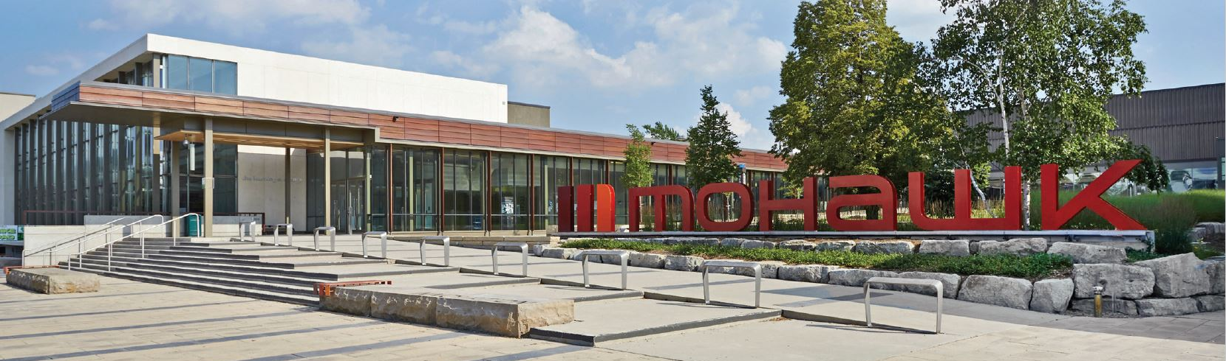
About Mohawk College
Located in Hamilton, Ontario, Canada
Hamilton’s population: 500,000
Approx. 12,000 full-time students
150 programs - specialize in health and technology programs
3 campuses: Fennell (largest), Stoney Creek (Skilled Trades & Apprenticeships), McMaster University (Health)

Slide 5
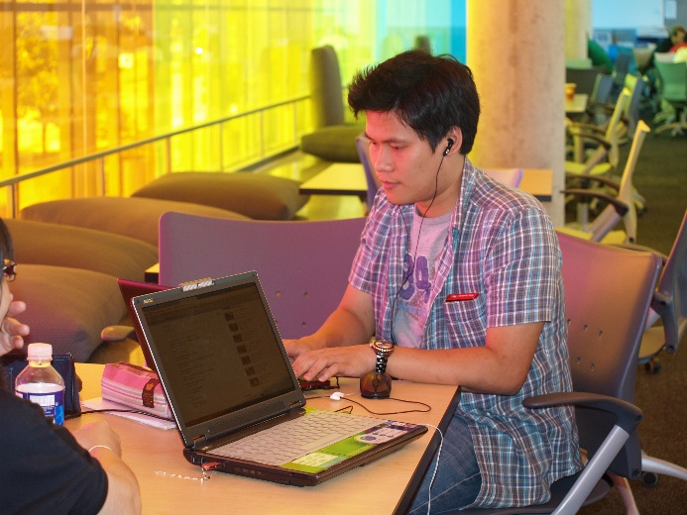
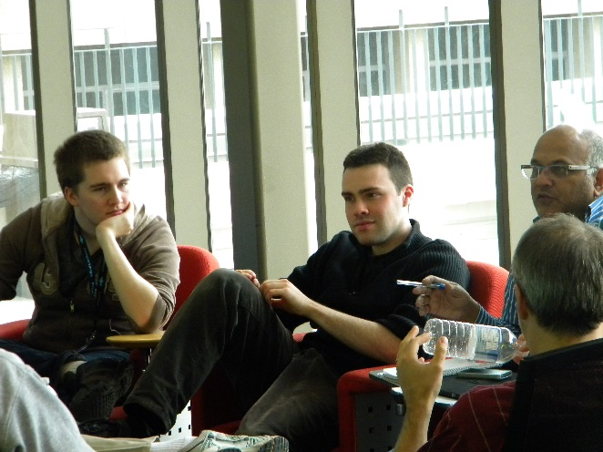
About Mohawk College Students
30 % of students arrive directly from high school
46% have previous postsecondary education
Approx. 13% are international

Slide 6
Project goals & background
Notes:
I’ll now give you some background regarding the Digital Skills Toolkit, and the goals of the project.

Slide 7
Why? – Institutional Priorities
Academic Plan: “Mohawk will support students, staff and faculty in becoming proficient with technology.”
Notes:
The toolkit was born of Mohawk College’s Institutional Priorities.
In Fall 2014, the Academic Plan project team recommended a digital skills remediation strategy that comprises in-person workshops and online modules in eight digital skills categories. Online modules would be available in the Learning Management System, and available to students upon acceptance to the college so that they could become familiar with the LMS before beginning classes.
The purpose, ultimately, is to provide assistance to students who are unfamiliar with the basic computer skills needed to succeed in the college’s blended learning environment.

Slide 8
Why? – Blended Learning College
Assumes students enter College with appropriate digital skills
need to provide support for new students
Blended Learning curriculum
need to provide supports for students since faculty have no time to cover in class
Faculty need the supports too!
Notes:
In 2009, Mohawk College embarked on an ambitious 5 year project to ensure all programs at Mohawk are blended. By December 2014, all Mohawk college programs were blended, meaning that 1/3 of the allotted time for the course had to be taught online and 2/3rds of taught f2f.
Typically, then a traditional 3-hour lecture course is now delivered 2 hours in-class and 1 hour online.
Through qualitative research, it was determined that faculty want digital skills support for their students since they do not want to waste valuable class time on technical content issues.
And since a portion of the faculty’s classes are online, faculty identified that they, too, could use digital skills support.
Though the DST was created to help students with their digital skills, staff and faculty are also able to benefit. The nature of the online toolkit enables users to explore modules and activities that ultimately improve their digital skills knowledge at a time, place, and pace that is convenient to them.
Faculty may also benefit by importing the DST resources directly into their eLearn courses. Instead of spending class time on, for example, how to create a spreadsheet, faculty can import the appropriate resource and assign it as a “just in time” learning exercise for their students, saving valuable class time otherwise spent on supplementary material.

Slide 9
Goals of the Project
Develop and implement Digital Skills Toolkit to provide students at Mohawk the basic digital skills needed to succeed at college. The toolkit comprises both online and in-person delivery of digital skills support and resources.
Notes:
As mentioned in our introduction, we found that not all students coming to college were prepared with the digital skills needed to succeed in their respective programs. The aim of the toolkit is to provide students at Mohawk College with the basic digital skills needed to succeed at college.
The toolkit comprises both online and in-person delivery of digital skills resources and support.

Slide 10
Digital Skills and Digital Literacies – What’s the Difference?
Digital Skills: needed to succeed in college (basic technical skills)
Digital Literacies: needed to succeed in college and beyond (higher level digital skills)
Notes:
There is often confusion regarding the difference between Digital Skills and Digital Literacies. We defined digital skills as those skills students need to succeed while in college – such as saving files, uploading assignments, editing Word documents, etc. Digital skills are foundational to achieve the higher-level digital literacies.
We defined Digital Literacies as the skills students need in order to succeed after they graduate. These higher level skills include evaluation of information when researching and completing tasks online, determining when info on Internet is safe to use, etc. “Digital Literacy is the ability to use information and communication technologies to find, evaluate, create, and communicate information, requiring both cognitive and technical skills.” (Louisiana State Library)
Digital literacies are illustrated in the “Information Management” Essential Employability Skills
For this project, we focussed on creating supports for students’ Digital Skills.

Slide 11
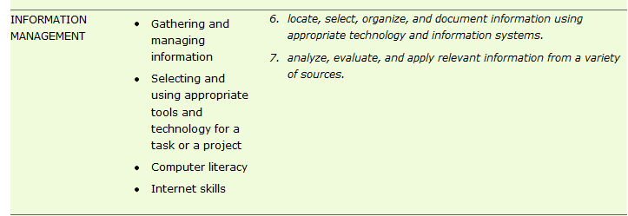
Digital Skills and Digital Literacies – What’s the Difference?
Digital Literacies: Aligned to Essential Employability Skills
Notes:
There is often confusion regarding the difference between Digital Skills and Digital Literacies. We defined digital skills as those skills students need to succeed while in college – such as saving files, uploading assignments, editing Word documents, etc. Digital skills are foundational to achieve the higher-level digital literacies.
We defined Digital Literacies as the skills students need in order to succeed after they graduate. These higher level skills include evaluation of information when researching and completing tasks online, determining when info on Internet is safe to use, etc. “Digital Literacy is the ability to use information and communication technologies to find, evaluate, create, and communicate information, requiring both cognitive and technical skills.” (Louisiana State Library)
Digital literacies are illustrated in the “Information Management” Essential Employability Skills
For this project, we focussed on creating supports for students’ Digital Skills.

Slide 12
A Model for Digital Literacy
From: Media Awareness Network. (2010, July 6). Digital Literacy in Canada: From Inclusion to Transformation. A Submission to the Digital Economy Strategy Consultation. Retrieved from: https://www.ic.gc.ca/eic/site/028.nsf/vwapj/DigitalLiteracyPaper.pdf/$file/DigitalLiteracyPaper.pdf page 7
Notes:
This Model for Digital Literacy illustrates the foundational digital skills in the “Access” to “Use” area focussing on competence and opportunity to build on these skills, to the evolution of Digital Literacy – found in the higher level “Understand” and “Create” area. Students work toward Digital Literacy in their program of study where they should gain the problem-solving, creativity, and decision-making skills employers are after.
Again, for the toolkit, the focus is to address the foundational Digital Skills – looking at the “Access” to “Use” (on the way to “Understand” and “Create” – Digital Literacy in POS)

Slide 13
Question for Audience
Do you find that students are entering with the fundamental digital skills required to succeed in college or university?
Notes:
- Show of hands how many, then ask for any anecdotes.

Slide 14
Research Conducted…
Surveys
Students – 1624 respondents
Faculty – 216 respondents
Interviews
Literature Review
Environmental scan
Trial of software
Notes:
Originally, a Digital Skills Assessment and Remediation project team researched Digital Skills Assessment tools, reviewed possible remediation strategies, and surveyed students and faculty to determine the specific skills students need to succeed in college. There were over 1600 responses to the student survey, which indicated great interest in the topic, and there were over 200 faculty survey responses which also illustrated significant interest in the topic of Digital Skills.
Face-to-face interviews were conducted with approximately 50 faculty, administrators, and support staff at Mohawk, and approximately 25 faculty, administrators, and support staff at other institutions were also consulted.
An environmental scan, literature review, and trials of various assessment tools were also completed in the Fall semester of 2014.
Contacted colleges in the area
Trialed various assessment tools (30 student trial) – Accuplacer’s Computer Skills Placement tool:
http://www.csplacement.com/
Most students strongly agreed that the assessment tool was effective in diagnosing the areas where they needed help and that it was easy to use.
Reviewed literature

Slide 15
Literature Review
“Students today are certainly exposed to and immersed in digital media. But their ability to use information technology to solve common business and real-world problems is frequently over-estimated.” (Murray, 2014, p. 88 )
“Today's university students are familiar with several local and Web applications such as Facebook, YouTube and games, and use these as part of their daily lives.... Studies proved that the new generation very rarely uses emerging technologies to retrieve, assess, store, produce, present and exchange information, all of which are basic skills of digital competency.” (Somyürek, S., & Coşkun, B. K. , 2013, p. E166)
Notes:
A review of the literature shows that “technology competencies are often taken for granted”, putting many students who lack the requisite computer and Internet skills at a disadvantage. As we may have seen, students today are immersed in digital media, but their ability to use the technology for real-world problems is often over-estimated. Because students are familiar with Twitter, Instagram, and the like, this doesn’t prove competency of digital skills or literacies.

Slide 16
What were the top three skills that faculty thought were necessary for students to be successful in their coursework?
Learning Management System (eLearn)
Word processing
Presentation
Spreadsheet
File management
Email
Browsers
Operating Systems (e.g. Windows, iOS)

Slide 17
What were the top three skills that faculty thought were necessary for students to be successful in their coursework?
Learning Management System (eLearn)
Word processing
Presentation
Spreadsheet
File management
Email
Browsers
Operating Systems (e.g. Windows, iOS)

Slide 18
What were the top three skills that faculty thought students were missing?
Learning Management System (eLearn)
Word processing
Presentation
Spreadsheet
File management
Email
Browsers
Operating Systems (e.g. Windows, iOS)

Slide 19
What were the top three skills that faculty thought students were missing?
Learning Management System (eLearn)
Word processing
Presentation
Spreadsheet
File management
Email
Browsers
Operating Systems (e.g. Windows, iOS)

Slide 20
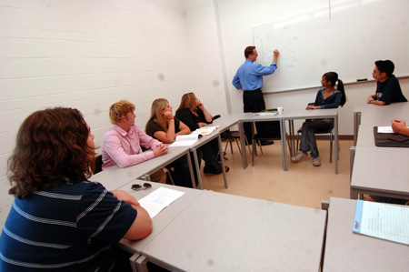
Faculty Comments
“In general, the students come to us with weak computer skills. High schools are not preparing the students to be computer literate, and we’ve seen that here for a long time. With the prevalence of hand-held devices, we’re finding their skills in using an Operating System are even weaker than they were 5 or so years ago.”
Notes:
Through the faculty survey, comments indicated that high school graduates are not coming to college prepared with the digital skills needed to succeed in their college programs.
Quotes include:
“Unless it’s being put in the secondary school curriculum, it cannot be expected that incoming students will have these skills.”
And
“In general, the students come to us with weak computer skills.” – and some faculty indicated that they saw a decline in computer skills over the last few years.
“We can't afford to turn away students with poor skills, so the only alternative is to offer pathways to bridge gaps so that this competency barrier doesn't impede their ability to learn. Unless it's being put in the secondary school curriculum, it cannot be expected that incoming students will have these skills.”
“Students are plugged into iPhones/smart phones/tablets but this does not mean they are able to navigate eLearn, manage files, download/upload files, select appropriate file types for saving, use word- processing/presentation software, etc. These skills are - in general - not practiced on a regular basis or in required high school courses.”

Slide 21
Faculty Comments
“There are always students who think they know how to use these tools but do not. Students don't know how to create a .zip file, don't know how to find the file they saved, don't know how to set tabs and margins in Word, don't know that Excel has formulas. It's been getting worse over the years.”
Notes:
Other quotes: “Just like math and English, we expect a certain level and when they are not there they get lost.”
“I'm always surprised that there is such a range of skill levels in my classes, despite the students being of similar ages and completing similar high school courses of study. Digital natives? I think not.”
Though students are proficient with social media, this does not mean they are able to navigate the college’s Learning Management System, mange files, or use presentation software. According to comments from the faculty survey, students are generally not proficient in the type of computer skills needed to succeed in college.
“Some believe students possess advanced computer skills since they are connected to technology however the social technology they are connected to is very different than learning technologies - it isn't smart to assume that students have the skills since a deficit may influence their ultimate success”
“I was always under the impression that students entering college would be savvy when it came to computer skills. They know how to text but they have a hard time with software, file management and eLearn. Even though we offer a course in semester one that covers these skills any other assistance to our students would be a benefit.”
Faculty also noted that digital skills knowledge may not be based on age, as one might expect, and they thought by addressing students’ digital skills gap, the college would see an increase in student retention.
Some comments in the survey also made mention of digital issues taking up valuable class time.

Slide 22
What were the top three skills that students thought were necessary to be successful in their coursework?
Learning Management System (eLearn)
Word processing
Presentation
Spreadsheet
File management
Email
Browsers
Operating Systems (e.g. Windows, iOS)

Slide 23
What were the top three skills that students thought were necessary to be successful in their coursework?
Learning Management System (eLearn)
Word processing
Presentation
Spreadsheet
File management
Email
Browsers
Operating Systems (e.g. Windows, iOS)

Slide 24
What were the top three skills that students thought they were missing/needed help with?
Learning Management System (eLearn)
Word processing
Presentation
Spreadsheet
File management
Email
Browsers
Operating Systems (e.g. Windows, iOS)

Slide 25
What were the top three skills that students thought they were missing/needed help with?
Learning Management System (eLearn)
Word processing
Presentation
Spreadsheet
File management
Email
Browsers
Operating Systems (e.g. Windows, iOS)

Slide 26
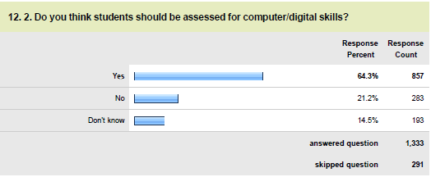
Digital Skills – Student Survey
Similar findings as to what students think they need in terms of digital skills (LMS, Word Processing, File Management…)
64% students said they would like a digital skills assessment – conceivably to assess in or out of a computer course
Notes:
The faculty and student surveys had similar findings in terms of which digital skills were needed for students to succeed in college.
Interestingly, 64% of students said that they would like a digital skills assessment – possibly to assess in or out of a computer course in their program of study.

Slide 27
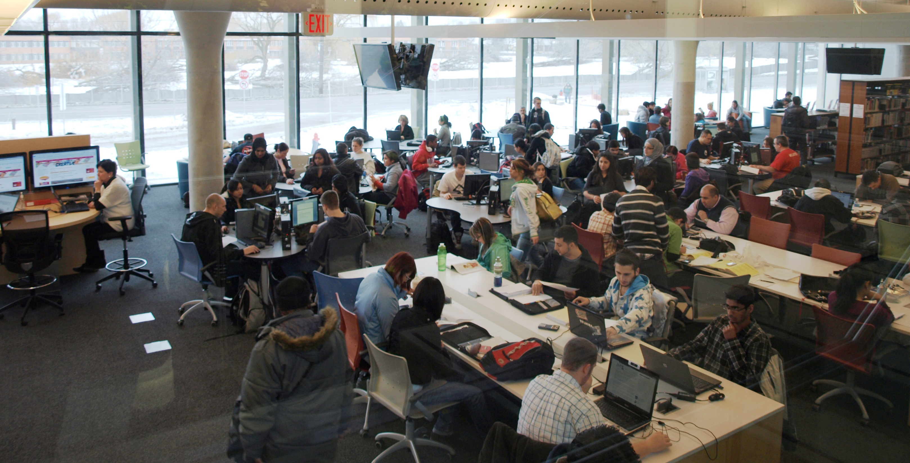
Student Survey Comments
“I am failing due to my lack of computer skills.”
“I thought what I had was basic computer skills until I started and fell behind.”
“Need sessions before class, or right at the beginning of semester.”

Slide 28
Student Survey Comments
“I NEEDED HELP WHEN I BEGUN [SIC] THE PROGRAM, ESPECIALLY THE E-LEARN SYSTEM.”
“lots of help and how to use the computer.”
“If you don't know how to use the internet to teach content to yourself without the aid of a teacher your [sic] toast.”
Notes:
Comments from students who completed the survey indicate a need for digital skills support. (and we can infer these students may need to brush up on their writing skills as well.)

Slide 29
DSAR ~> DST
Original project title: Digital Skills Assessment and Remediation
Decision made to remove formal “assessment” piece from the project
Project’s focus is now on providing digital skills resources and workshops – a Digital Skills Toolkit
Notes:
The Digital Skills Assessment and Remediation project evolved into the “Digital Skills Toolkit” project when the decision was made to remove the “assessment” piece from the project.
Adding a Digital Skills Assessment to the current Reading, Writing, and Mathematics assessments (not to mention the “Student Entrance Survey”) would have added another hour to this 4 hour assessment period. This was deemed to be too much for students, not to mention the strain it would place on the current assessment department staffing, resources, and allocated space in the college. Also, to have a proper assessment and remediation system in place to address students’ computer skills, the college would need to ensure a remedial computer course could be available to all POS’s – and in most cases, there was no space in the POS to add the course.

Slide 30
What is it?

Slide 31
Digital Skills Toolkit
Content in the LMS
lynda.com content/free content/original content
Activities, quizzes
Same Content on Student Technical Support Website
lynda.com content/free content/original content
Workshops
20-30 minutes on each skill area
Launched August, 2015

Slide 32
Digital Skills Toolkit
AND
In-person workshops at each campus
Workshops every week throughout semester
At standard times/locations
Offered by Library TECH Bars
Online modules
Accessible in eLearn through a widget on My Home
Student completes the modules they need
Accessible upon registration (2016)
Accessible via Student Tech Support site outside of eLearn

Slide 33
8 Digital Skills Categories
eLearn@Mohawk
Computer Foundations
File & Folder Management
Microsoft
Excel
Microsoft Office 365
Microsoft Word
Microsoft PowerPoint
Internet
& Online Communication

Slide 34
Digital Skills Categories – Associated Training Goals
eLearn
Microsoft PowerPoint
Microsoft Excel
File/folder management
Computer foundations
Internet/online communications
Office 365
Microsoft Word
Add a header with your name to a document
Make a paragraph double-spaced
Training goal: Create a properly formatted document for assignment submission

Slide 35
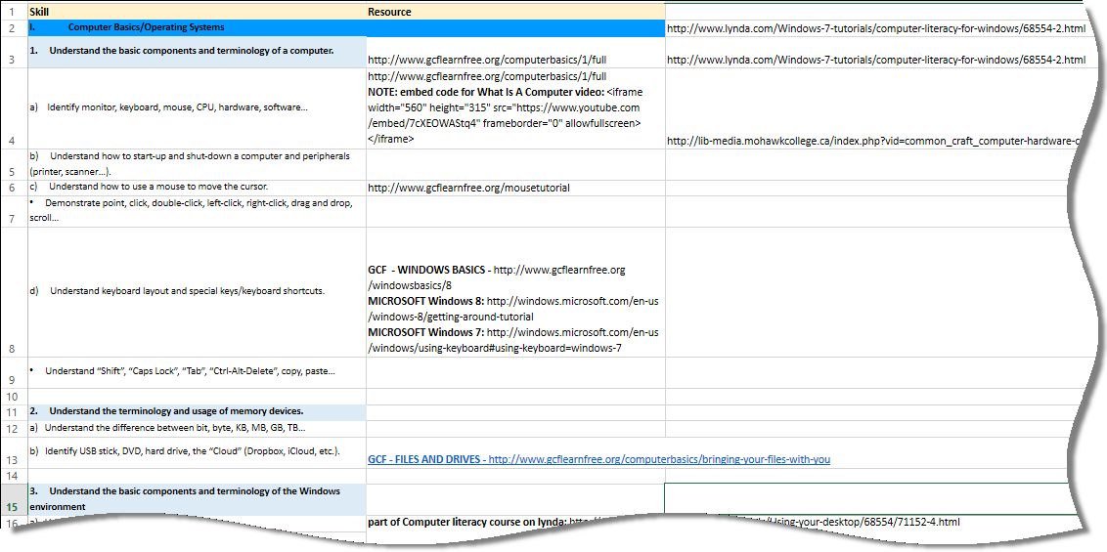
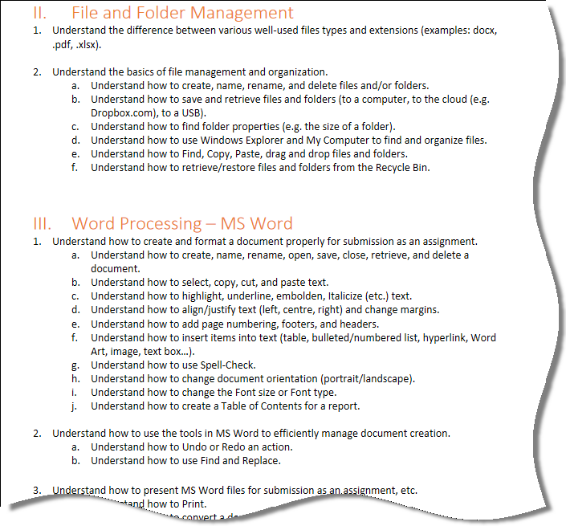
Skills and Training Goals

Slide 36
Embed Digital Skills Toolkit Modules
Faculty can import any/all modules and quizzes into their course
INFOsheet guides faculty through the steps

Slide 37
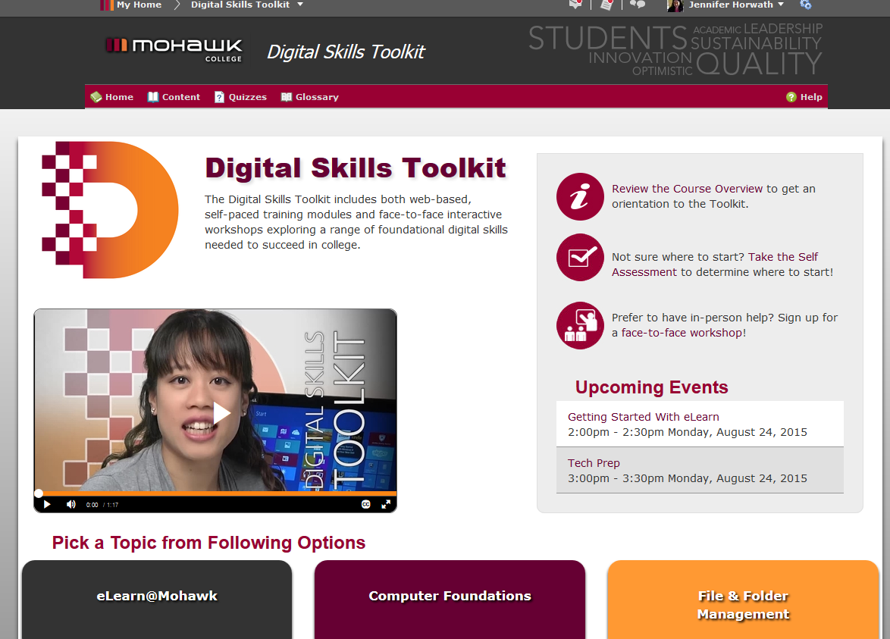
Toolkit in the LMS in eLearn

Slide 38
Self-Assessment
Students can determine areas where they need help before getting started…
Access it from the Digital Skills Toolkit homepage in eLearn

Slide 39
Self-Assessment Tool Links
Assessment Tool: http://spin.mohawkcollege.ca/ctl/dst/story_html5.html
Accessible Version:
http://spin.mohawkcollege.ca/ctl/dst_a/story_html5.html

Slide 40
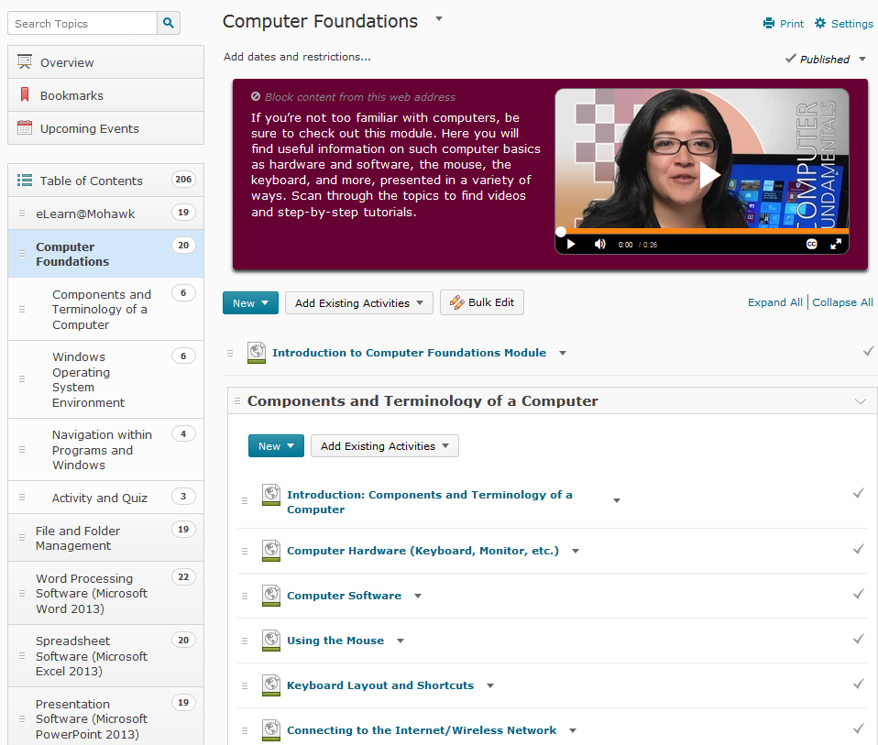
Toolkit in LMS
Sub-Topics
Training Components

Slide 41
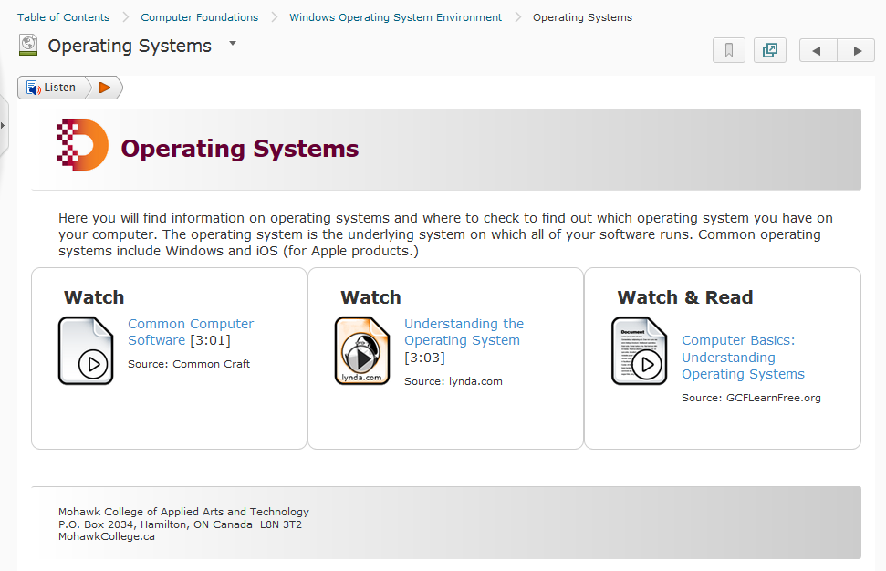
Example of Toolkit in LMS
Guides and tutorials

Slide 42
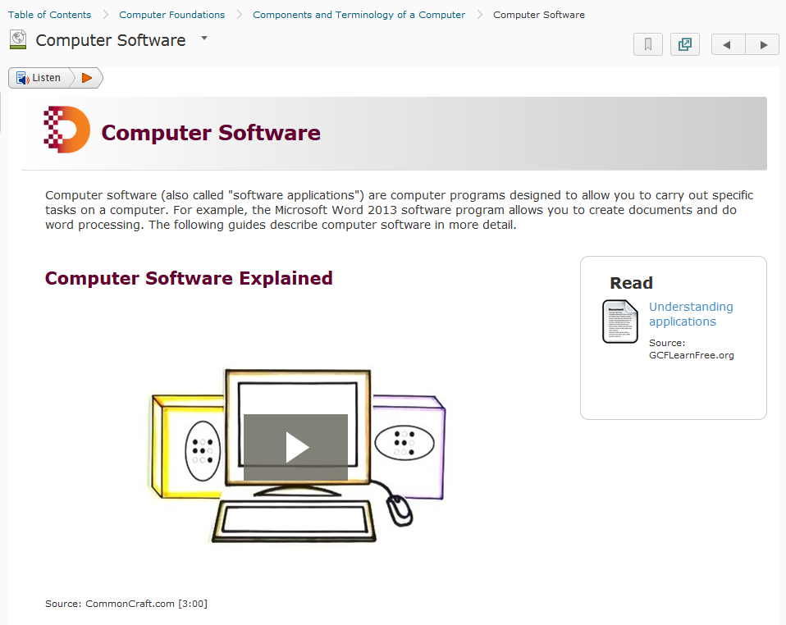
Example of Toolkit in LMS

Slide 43
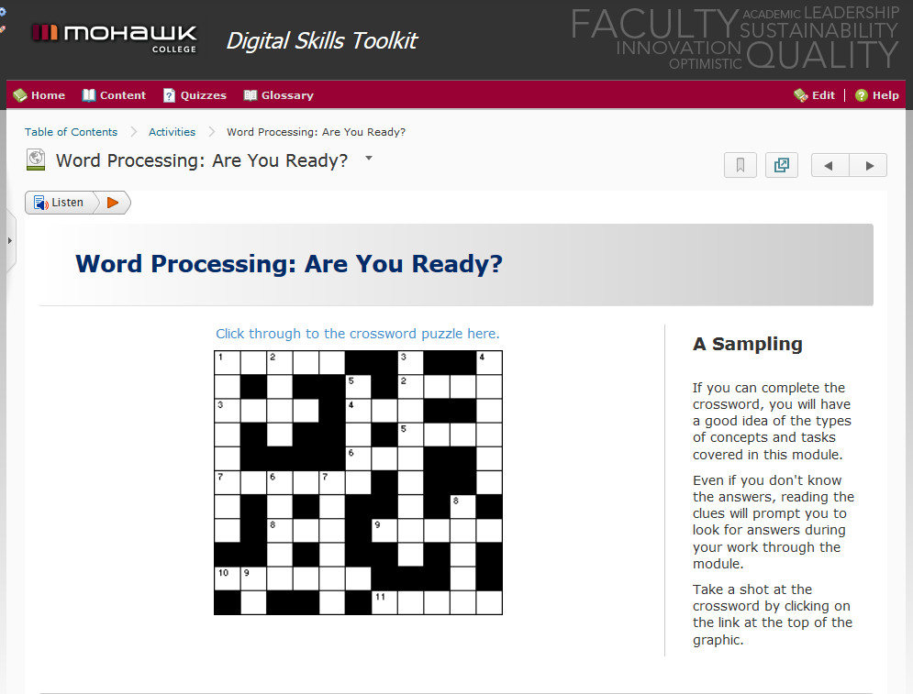
Example of Activity

Slide 44
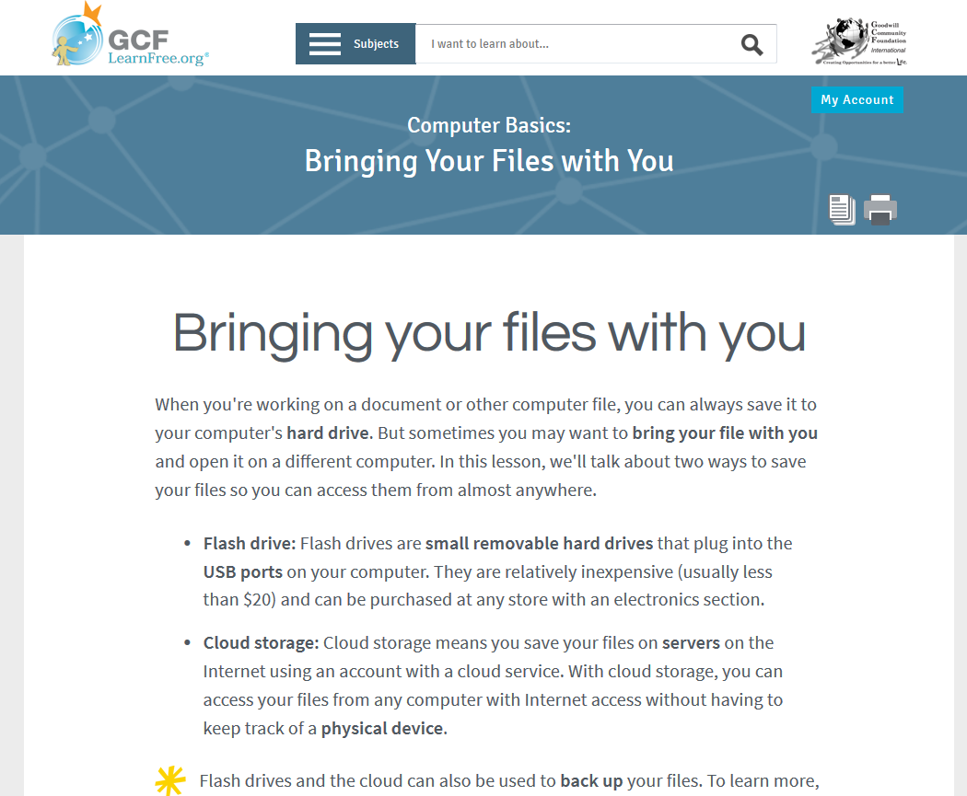
Examples of Resources
From: http://www.gcflearnfree.org/computerbasics/bringing-your-files-with-you/1/
Notes:
Goodwill Community Foundations – excellent resource.

Slide 45
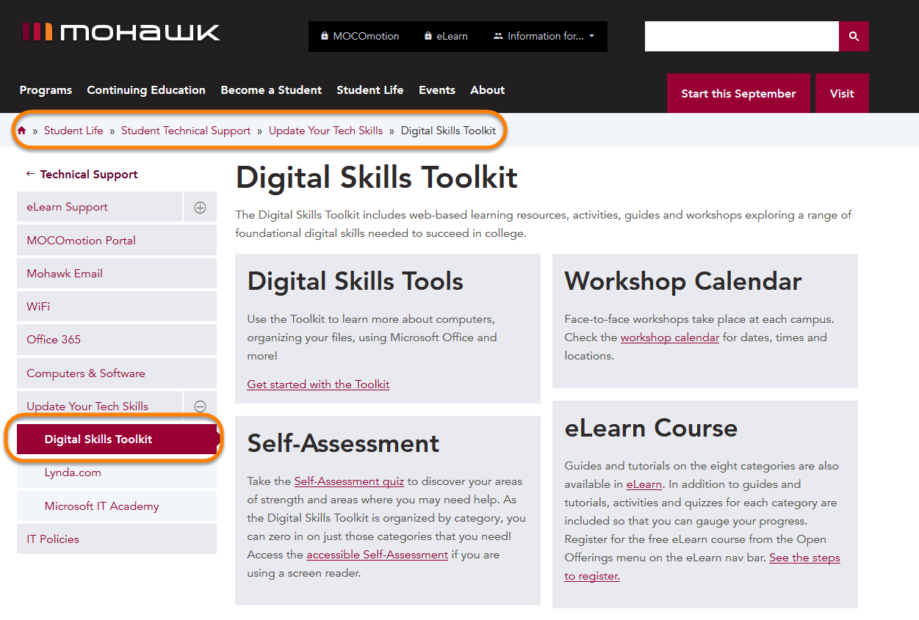
Technical Support Page
http://www.mohawkcollege.ca/DigitalSkillsToolkit

Slide 46
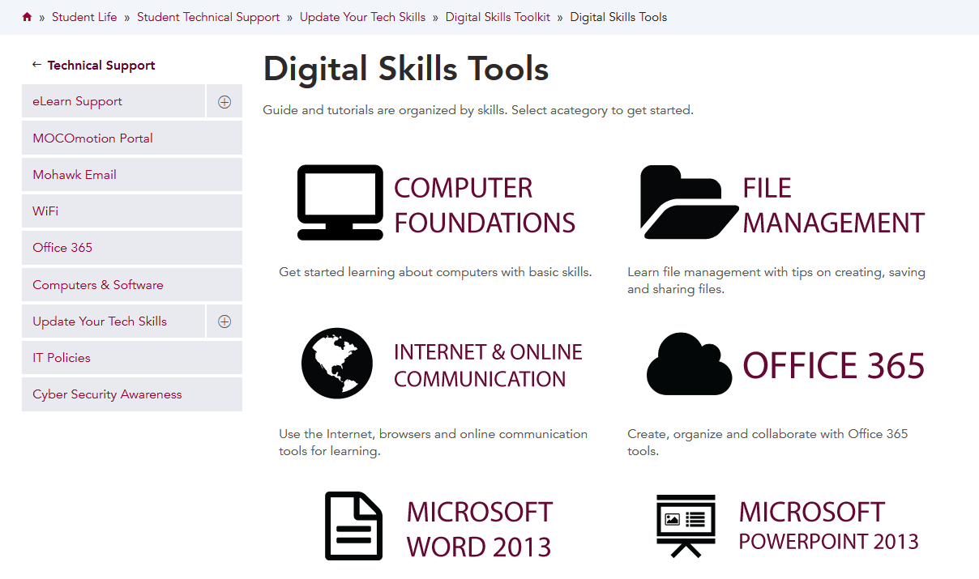
DST on College Website

Slide 47
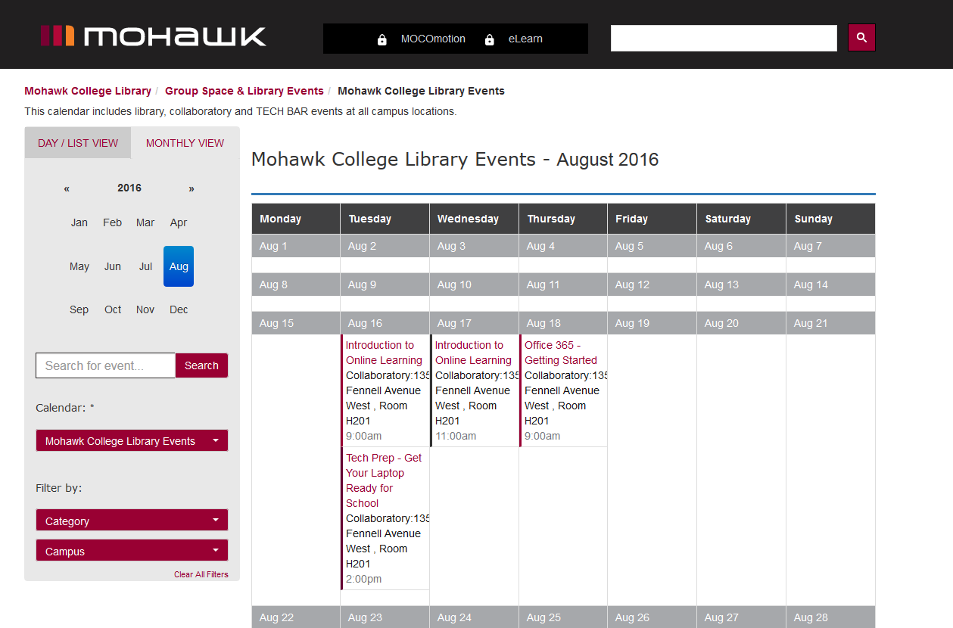
Workshop Calendar
http://mohawkcollege.ca.libcal.com/calendar/libraryevents

Slide 48
Project implementation

Slide 49
Project Scope of Work
Identify project team/processes
Identify Team
Kickoff Meeting
Create meeting schedule
Project timeline
Develop/Design eLearn Course Area
Design and develop toolkit in eLearn (look and feel, layout, navigation, assessments, etc.)
Curate Content
Curate licensed and free content to add to the eLearn course (based on Skills Categories already identified)
Communications about DST
Communicate to all key stakeholders about DST
Develop messaging/collateral
Workshop Development
Design and develop hands-on workshops
Develop schedule for rotating workshops throughout semester
Develop assessments for workshops
Assess Digital Skills Toolkit
Usability testing with MSA reps
Assess DST at end of each term

Slide 50
Project Communications
Students:
Info in Fee Package (for Winter 2016 semester)
Assessments for Success communications
eBlasts
Signage
Social media
LMS
Messaging via their faculty
Postcards
MSA meetings
Notes:
Students:
Info in Fee Package (for Winter 2016 semester)
Assessments for Success communications
eBlast sent from Registrar’s Office (Fall 2015 and 2016 students)
Hallway signage – print/digital
Social media (via MSA social media and College social media)
Message and widgets in LMS & portal
Messaging via their faculty
Postcards to be handed out from frontline service points
Faculty
Departmental meetings (August)
One-pager that outlines how to access and what is included/Email
PD sessions offered by CTL
Messaging from Deans/ADs

Slide 51
Response from stakeholders

Slide 52
Student Response
2,155 enrolled in the DST course in the LMS as of Winter, 2017
Average time on content per session: 21:32 minutes
Average # of unique visitors per sub-module: 55
Average time per sub-module: 2 minutes
~60 attendees at workshops per semester in 2015/16
Surveyed at end of Fall and Winter terms
469 responses in Fall 2015 | 232 in Winter 2016 | 203 in Fall 2016

Slide 53
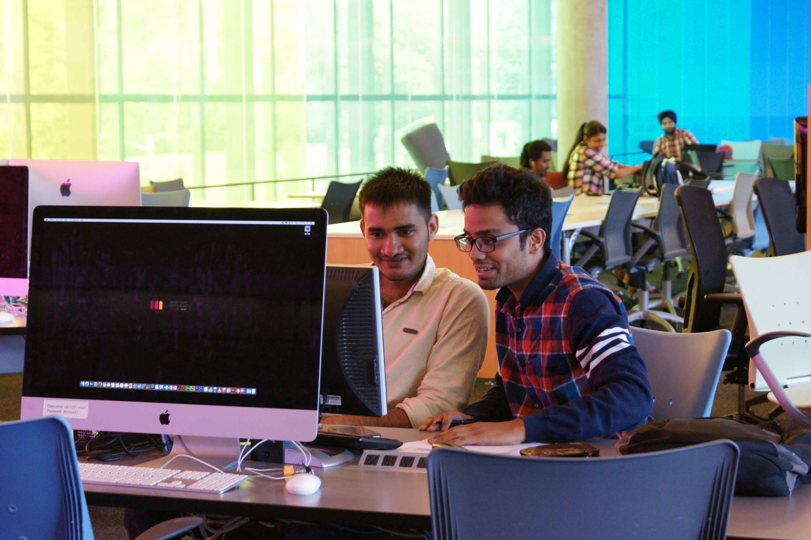
Student Response
Results:
Approx. 80% used the LMS version of the Toolkit
Most popular module: eLearn (LMS), 2nd most popular: Word
Most (67%) found it easy/very easy to navigate, at the right level (84%) and the resources helpful/very helpful (78-86%)
Most (77-81%) found workshops to be at “right level”

Slide 54
Student Response - Overall
Most would recommend the Toolkit to classmates (94% agree/strongly agree)

Slide 55
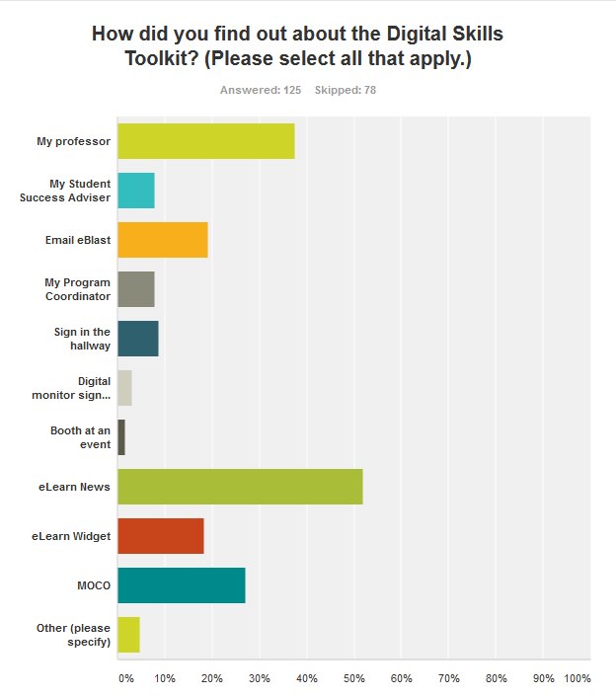
Student Response - Awareness

Slide 56
Student Response – Overall – Areas for Improvement
Too much information per page
Too many topics – some are too advanced
Workshops – would like advanced topics

Slide 57
Other Areas for Improvement
Incentivizing the workshops
Building faculty buy-in

Slide 58
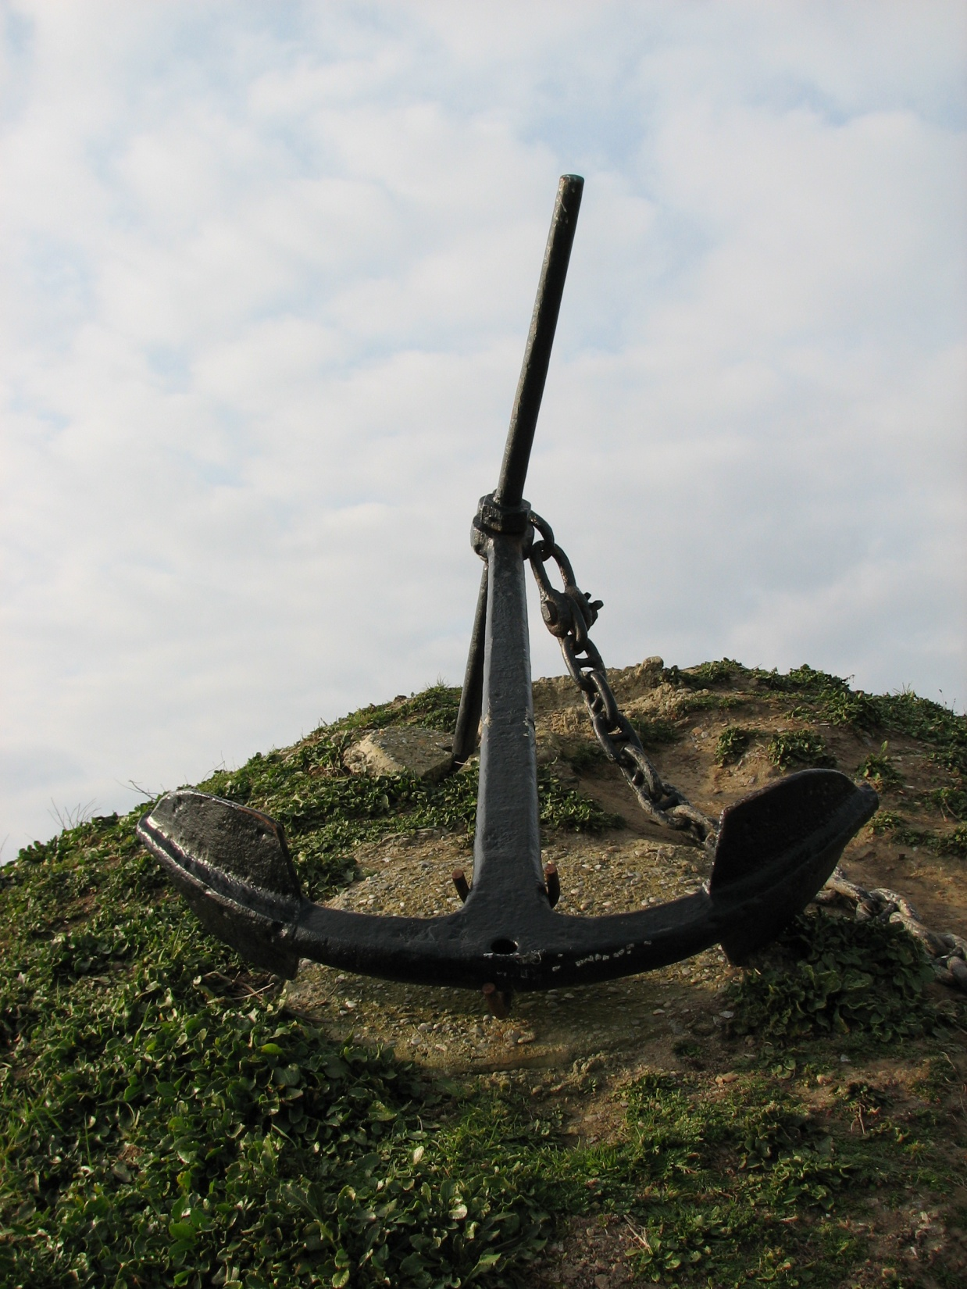
Photo credit: Atif Gulzar, Freeimages.com
Notes:
This is a picture of an anchor, the significance being that we understood from the start that providing remediation or extra help to people who are already struggling with a full course load is a bit like throwing an anchor to a drowning person. We understand this and hope that the College may look at other ways to provided digital skills resources to students besides as an ‘extra’.

Slide 59
Next steps

Slide 60
Project Next Steps
Ongoing maintenance
Incentive for students (Certificate of Attendance, Co-Curricular Record)
Efficacy review – is it working?
New modules under future consideration:
Financial literacy
Digital literacy

Slide 61
Resources
Chinien, C. & Boutin, F. (April 2011). Defining Essential Digital Skills in the Canadian Workplace: Final Report. Human Resources and Skills Development Canada. Retrieved from: http://en.copian.ca/library/research/digi_es_can_workplace/digi_es_can_workplace.pdf
Goodwill Community Foundation (2015). Retrieved from: http://www.gcflearnfree.org/
Government of Canada. (2014, April 4). Building Digital Skills for Tomorrow. In Digital Canada 150. Retrieved from https://www.ic.gc.ca/eic/site/028.nsf/eng/00041.html
ICDL Canada. (2015). Computer use skill certification. Retrieved from: http://www.icdl.ca/index.php?lang=en
International Society for Technology in Education (ISTE). (2007). ISTE standards: Students. Retrieved from: http://www.iste.org/docs/pdfs/20-14_ISTE_Standards-S_PDF.pdf
Katz, I.R. (January 2007). ETS research finds college students fall short in demonstrating ICT literacy: National Policy Council to create national standards. C&RL News. Retrieved from: http://crln.acrl.org/content/68/1/35.full.pdf
Media Awareness Network. (2010, July 6). Digital Literacy in Canada: From Inclusion to Transformation. A Submission to the Digital Economy Strategy Consultation. Retrieved from: https://www.ic.gc.ca/eic/site/028.nsf/vwapj/DigitalLiteracyPaper.pdf/$file/DigitalLiteracyPaper.pdf
Murray, M. C., & Pérez, J. (2014). Unraveling the Digital Literacy Paradox: How Higher Education Fails at the Fourth Literacy. Issues in Informing Science & Information Technology, 85-100. http://ezproxy.mohawkcollege.ca:2048/login?url=http://search.ebscohost.com/login.aspx?direct=true&db=aph&AN=96357849&site=ehost-live&scope=site
Somyürek, S., & Coşkun, B. K. (2013). Digital competence: Is it an innate talent of the new generation or an ability that must be developed?. British Journal of Educational Technology, 44(5), E163-E166. doi:10.1111/bjet.12044 http://ezproxy.mohawkcollege.ca:2048/login?url=http://search.ebscohost.com/login.aspx?direct=true&db=aph&AN=89680346&site=ehost-live&scope=site
The Conference Board of Canada. (2015). Employability Skills 2000+. Retrieved from: http://www.conferenceboard.ca/topics/education/learning-tools/employability-skills.aspx

Slide 62
Questions? Comments?

Slide 63
mohawkcollege.ca/DigitalSkillsToolkit

